Slide 1
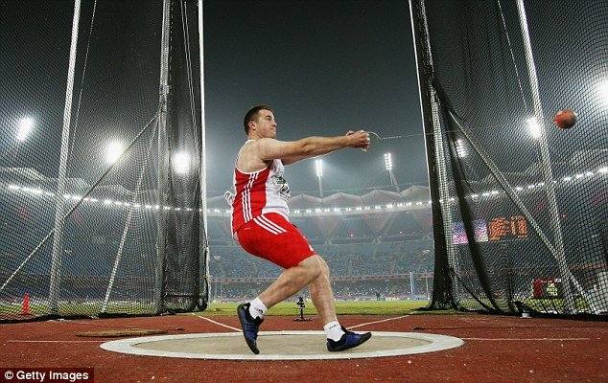
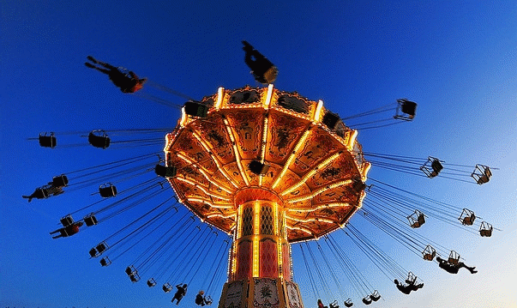
Horizontal Circular Motion

Slide 2
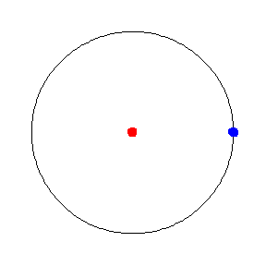
Uniform Circular Motion
This describes an object going around a circle at constant speed

Slide 3
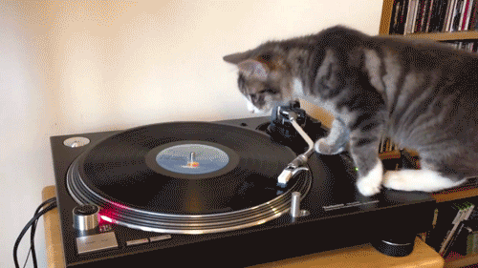
Example

Slide 4
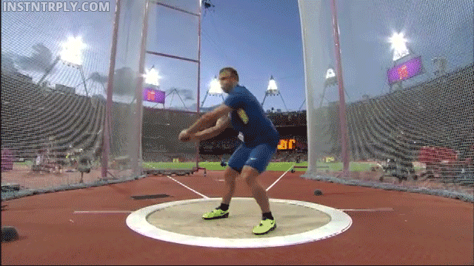
Other examples

Slide 5
Not uniform velocity
It is important to remember that though the speed is constant, the direction is changing all the time, so the velocity is changing.
Uniform speed ≠ uniform velocity

Slide 6
Direction of centripetal acceleration/force
Change in velocity
v
Δv = v - u
u
Δv = v + -u
Δv =
Velocity is always tangential to its path.
The change in velocity (and thus the acceleration) is directed towards the centre of the circle.

Slide 7
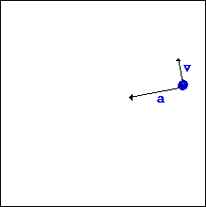
Direction of centripetal acceleration towards the centre

Slide 8
Calculating Circular Speed
v = s ⁼ 2πr
t T
Where r is the radius of the circle and T is the period of a single rotation.

Slide 9
Calculating Circular Speed
f = 1 v ⁼ 2πr f
T
Where r is the radius of the circle and T is the period of a single rotation.

Slide 10
How big is the centripetal acceleration?
a = v² ⁼ 4π²r
r T²
where a is the centripetal acceleration (m.s⁻²), r is the radius of the circle (m), v is the constant speed (m.s⁻¹) and T is the orbital period (s).

Slide 11
How big is the centripetal force?
F_{c} = ma = mv²
r
from F = ma (Newton’s 2nd law)

Slide 12
Prove a = v²/r

Slide 13
Uniform Circular Motion
Remember we have already looked at circular motion
Centripetal acceleration = v²/r
Centripetal force = mv²/r
velocity

Slide 14
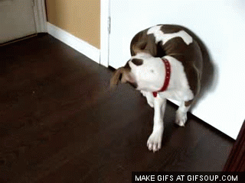
Circular motion at Home

Slide 15
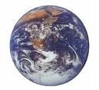
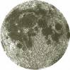
Uniform Circular Motion
For orbital motion, the centripetal force is provided by gravity
Earth’s gravitational attraction on moon

Slide 16
Uniform Circular Motion
centripetal force = force of gravity
m_{m}v² = Gm_{e}m_{m}
r r²
v² = Gm_{e}
r
Earth’s gravitational attraction on moon

Slide 17
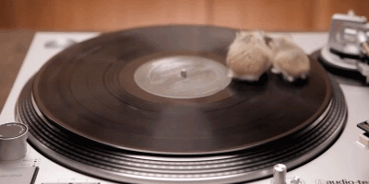
Example
Two small furry gerbils are taking a ride on an old school turntable spinning at 33⅓ rpm.
If the gerbils are sitting 10.0 cm and 15.0 cm and each has a mass of 40g, which gerbil will require the greatest frictional force between their feet and the record to stay in place?
Support your answer with calculations.

Slide 18
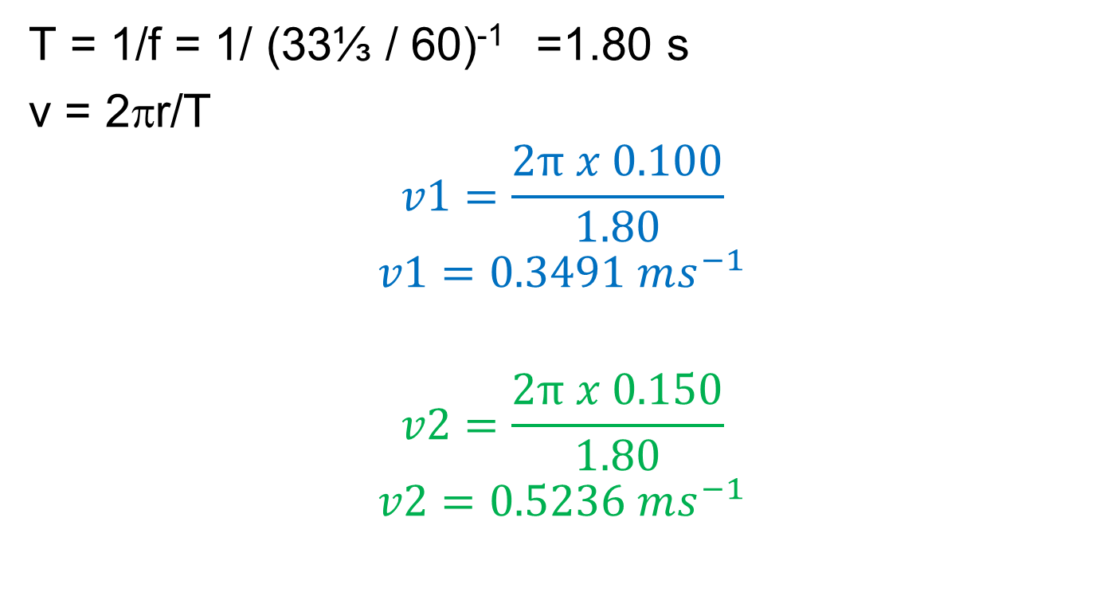
Example
T = 1/f = 1/ (33⅓ / 60)⁻¹ =1.80 s
v = 2πr/T
$$v1=\frac{2π x 0.100}{1.80}$$
$$v1=0.3491 ms^{−1}$$
$$v2=\frac{2π x 0.150}{1.80}$$
$$v2=0.5236 ms^{−1}$$

Slide 19
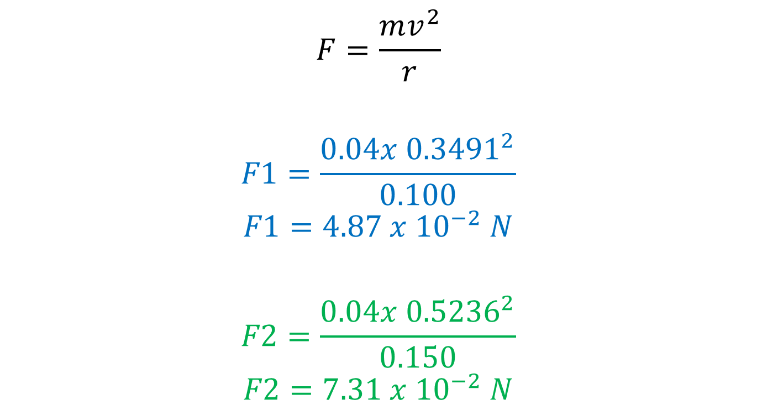
Example
$$F=\frac{mv^{2}}{r}$$
$$F1=\frac{0.04{x 0.3491}^{2}}{0.100}$$
$$F1=4.87 x {10}^{−2} N$$
$$F2=\frac{0.04{x 0.5236}^{2}}{0.150}$$
$$F2=7.31 x {10}^{−2} N$$
The outside gerbil needs the highest amount of friction to provide the required Centripetal force!

Slide 20
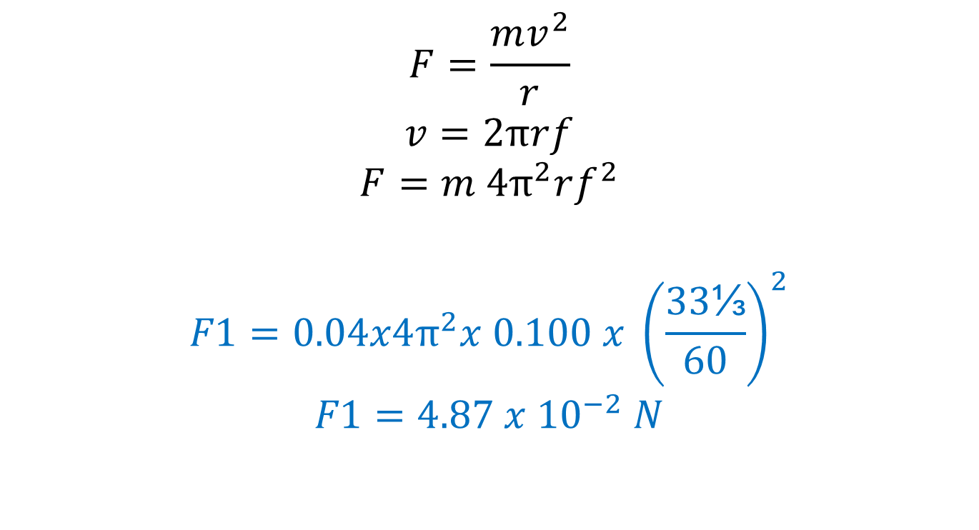
Shortcut for the experts
$$F=\frac{mv^{2}}{r}$$
$$v=2πrf$$
$$F=m 4π^{2}rf^{2}$$
$$F1=0.04x4π^{2}x 0.100 x {\left(\frac{33\text{⅓}}{60}\right)}^{2}$$
$$F1=4.87 x {10}^{−2} N$$

